Slide 1

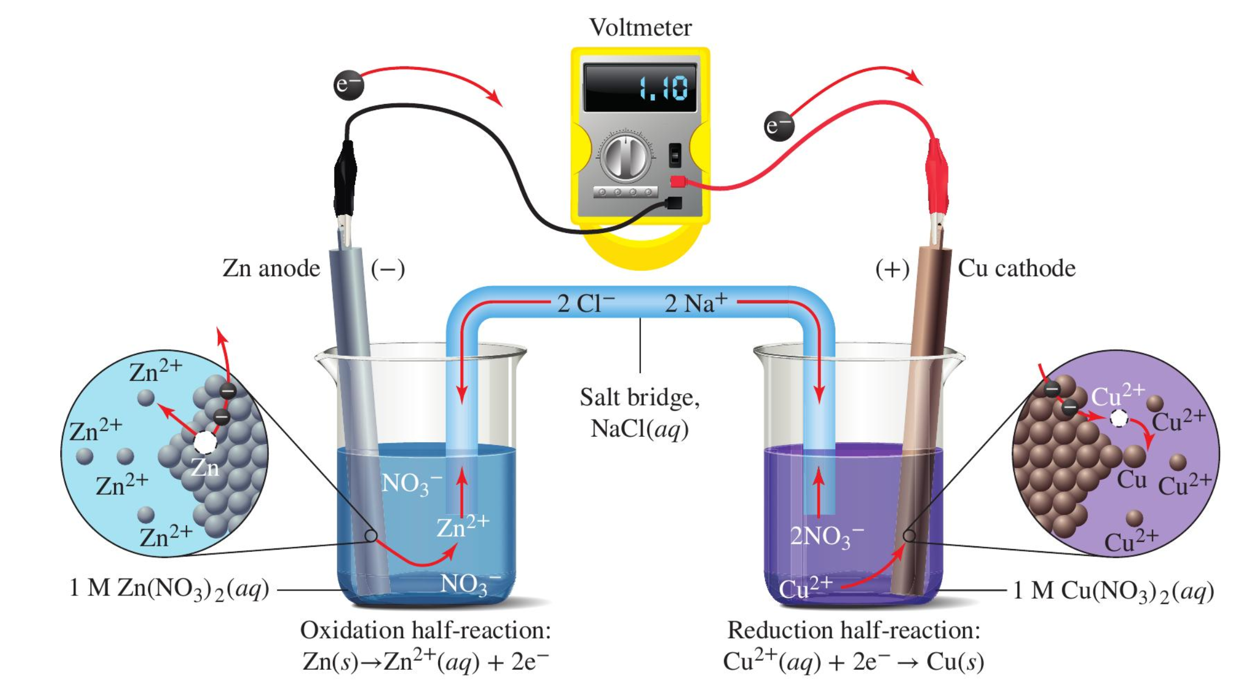


Recap: Daniell cell is a particular kind of Galvanic cell
Galvanic cells generally follow this pattern, but can have lots of different metals undergoing half-reactions.
This particular cell is called a Daniell cell because it uses copper and zinc

Slide 2
Recap: anode
The anode is where the oxidation half-reaction is happening

Slide 3
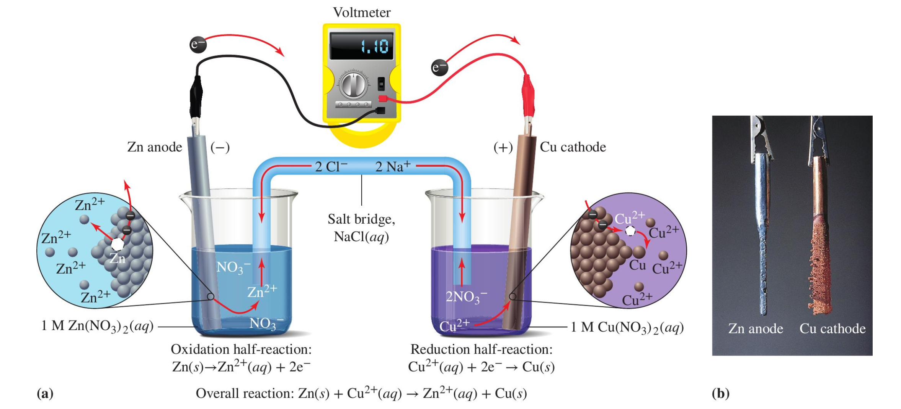
Molecular view of an anode
Here’s a molecular-level view of the oxidation half-reaction

Slide 4
Molecular view of an anode
Principle of charge neutrality:
All parts of the anode have to remain charge-neutral.
Here’s a molecular-level view of the oxidation half-reaction

Slide 5
Recap: cathode
The cathode is where the reduction half-reaction is happening

Slide 6
Molecular view of a cathode
Here’s a molecular-level view of the reduction half-reaction

Slide 7
Molecular view of a cathode
Charge neutrality applies to the cathode too
Here’s a molecular-level view of the reduction half-reaction

Slide 8
The anode and cathode also called electrodes

Slide 9
Between electrodes is the salt bridge
A salt bridge is necessary to “complete the circuit”

Slide 10
Between electrodes is the salt bridge
Is the salt bridge remaining charge-neutral?
A salt bridge is necessary to “complete the circuit”

Slide 11
Also between electrodes is the load
A load is necessary to “complete the circuit”

Slide 12
Voltmeter
A voltmeter is often put in place of the load to measure the voltage

Slide 13
Recap: four components of a Galvanic cell
Anode
Cathode
Salt Bridge
Load/voltmeter

Slide 14
Real cells vs these pictures
Real cells (like the ones you’ll make in lab) may look different, but they still have the four essential components!

Slide 15
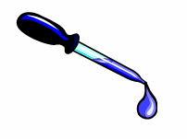
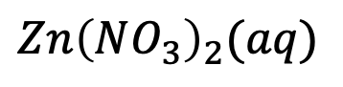
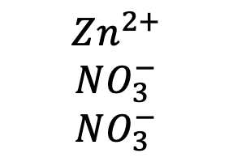
Filter-paper Daniell cell
$$Zn{\left(NO_{3}\right)}_{2}(aq)$$
$$Zn^{2+}$$
$$NO_{3}^{−}$$
$$NO_{3}^{−}$$

Slide 16
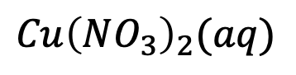
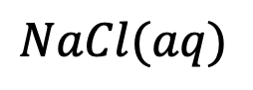
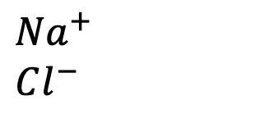
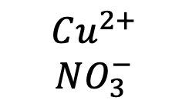
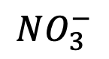
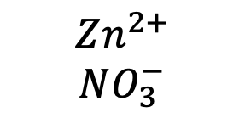
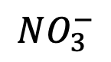
Filter-paper Daniell cell
$$NaCl(aq)$$
$$Cu{\left(NO_{3}\right)}_{2}(aq)$$
${Na}^{+}$
$$Cl^{−}$$
$$Zn^{2+}$$
$$NO_{3}^{−}$$
$$Cu^{2+}$$
$$NO_{3}^{−}$$
$$NO_{3}^{−}$$
$$NO_{3}^{−}$$

Slide 17
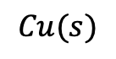
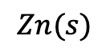
Filter-paper Daniell cell
${Na}^{+}$
$$Cl^{−}$$
$$Zn^{2+}$$
$$NO_{3}^{−}$$
$$Cu^{2+}$$
$$NO_{3}^{−}$$
$$NO_{3}^{−}$$
$$NO_{3}^{−}$$
$$Zn(s)$$
$$Cu(s)$$
Do we have all four components?

Slide 18
Filter-paper Daniell cell
${Na}^{+}$
$$Cl^{−}$$
$$Zn^{2+}$$
$$NO_{3}^{−}$$
$$Cu^{2+}$$
$$NO_{3}^{−}$$
$$NO_{3}^{−}$$
$$NO_{3}^{−}$$
$$Zn(s)$$
$$Cu(s)$$
Now we do

Slide 19
Filter-paper Daniell cell
${Na}^{+}$
$$Cl^{−}$$
$$Zn^{2+}$$
$$NO_{3}^{−}$$
$$Cu^{2+}$$
$$NO_{3}^{−}$$
$$NO_{3}^{−}$$
$$NO_{3}^{−}$$
$$Zn(s)$$
$$Cu(s)$$
Where half-reactions are taking place

Slide 20
Filter-paper Daniell cell
${Na}^{+}$
$$Cl^{−}$$
$$Zn^{2+}$$
$$NO_{3}^{−}$$
$$Cu^{2+}$$
$$NO_{3}^{−}$$
$$NO_{3}^{−}$$
$$NO_{3}^{−}$$
What about charge neutrality?
$$Zn(s)$$
$$Cu(s)$$

Slide 21
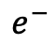
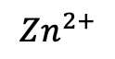
Filter-paper Daniell cell
${Na}^{+}$
$$Cl^{−}$$
$$Zn^{2+}$$
$$NO_{3}^{−}$$
$$Cu^{2+}$$
$$NO_{3}^{−}$$
$$NO_{3}^{−}$$
$$NO_{3}^{−}$$
$$Zn^{2+}$$
What about charge neutrality?
$$Zn(s)$$
$$Cu(s)$$
$$e^{−}$$

Slide 22
Filter-paper Daniell cell
${Na}^{+}$
$$Cl^{−}$$
$$Zn^{2+}$$
$$NO_{3}^{−}$$
$$Cu^{2+}$$
$$NO_{3}^{−}$$
$$NO_{3}^{−}$$
$$NO_{3}^{−}$$
$$Zn^{2+}$$
Maintaining charge neutrality in the anode
$$Zn(s)$$
$$Cu(s)$$
$$e^{−}$$

Slide 23
Filter-paper Daniell cell
${Na}^{+}$
$$Cl^{−}$$
$$Zn^{2+}$$
$$NO_{3}^{−}$$
$$Cu^{2+}$$
$$NO_{3}^{−}$$
$$NO_{3}^{−}$$
$$NO_{3}^{−}$$
$$Zn^{2+}$$
Maintaining charge neutrality in the cathode
$$Zn(s)$$
$$Cu(s)$$
$$e^{−}$$

Slide 24
Filter-paper Daniell cell
${Na}^{+}$
$$Cl^{−}$$
$$Zn^{2+}$$
$$NO_{3}^{−}$$
$$Cu^{2+}$$
$$NO_{3}^{−}$$
$$NO_{3}^{−}$$
$$NO_{3}^{−}$$
$$Zn^{2+}$$
Maintaining charge neutrality in the cathode
$$Zn(s)$$
$$Cu(s)$$
$$e^{−}$$

Slide 25
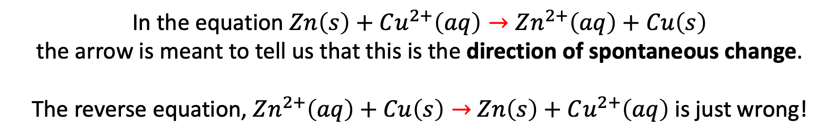
Convention on the direction of spontaneous change
In the equation $Zn\left(s\right)+Cu^{2+}\left(aq\right)→Zn^{2+}\left(aq\right)+Cu\left(s\right)$
the arrow is meant to tell us that this is the direction of spontaneous change.
The reverse equation, $Zn^{2+}\left(aq\right)+Cu\left(s\right)→$ $Zn\left(s\right)+Cu^{2+}\left(aq\right)$ is just wrong!

Slide 26
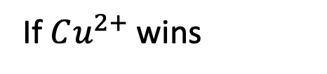
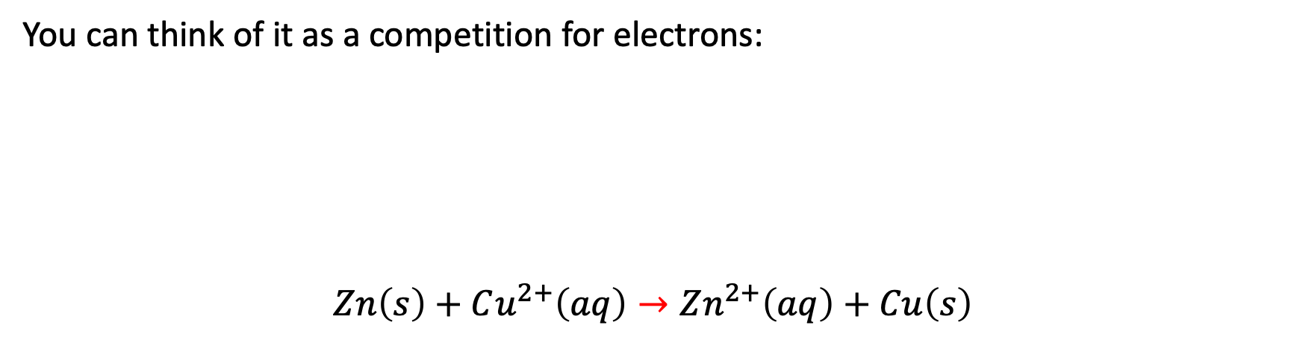
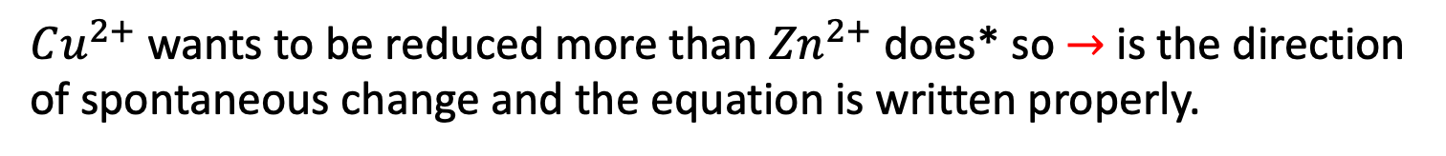
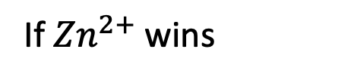
Predicting the direction of spontaneous change
You can think of it as a competition for electrons:
$$Zn\left(s\right)+Cu^{2+}\left(aq\right)→Zn^{2+}\left(aq\right)+Cu\left(s\right)$$
If $Cu^{2+}$ wins
If ${Zn}^{2+}$ wins
$Cu^{2+}$ wants to be reduced more than ${Zn}^{2+}$ does* so $→$is the direction of spontaneous change and the equation is written properly.

Slide 27
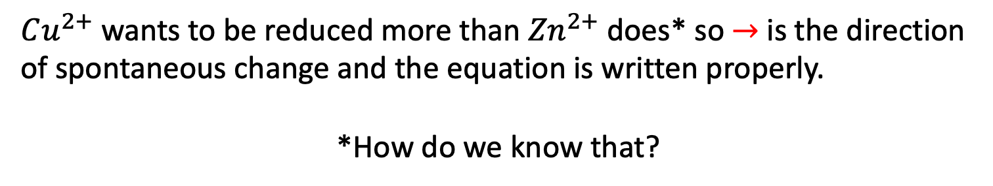
Predicting the direction of spontaneous change
You can think of it as a competition for electrons:
$$Zn\left(s\right)+Cu^{2+}\left(aq\right)→Zn^{2+}\left(aq\right)+Cu\left(s\right)$$
If $Cu^{2+}$ wins
If ${Zn}^{2+}$ wins
$Cu^{2+}$ wants to be reduced more than ${Zn}^{2+}$ does* so $→$is the direction of spontaneous change and the equation is written properly.
*How do we know that?

Slide 28
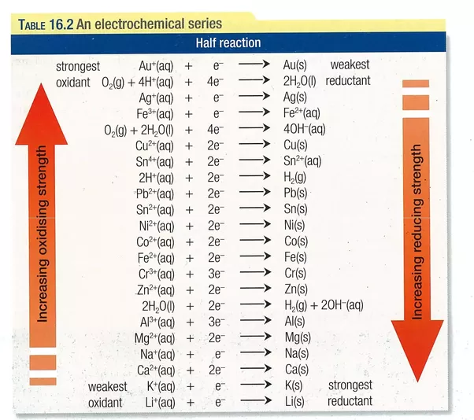
Electrochemical series to the rescue

Slide 29
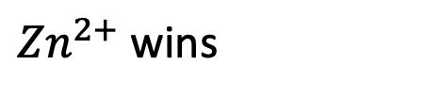
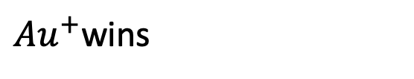
Practice using the electrochemical series to predict the direction of spontaneous change
Which the direction of spontaneous change? Which is anode/cathode?
${Zn}^{2+}$ wins
$$Zn\left(s\right)+2 {Au}^{+}\left(aq\right)→Zn^{2+}\left(aq\right)+2 Au(s)$$
${Au}^{+}$wins

Slide 30
Practice using the electrochemical series to predict the direction of spontaneous change

Slide 31
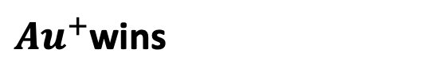
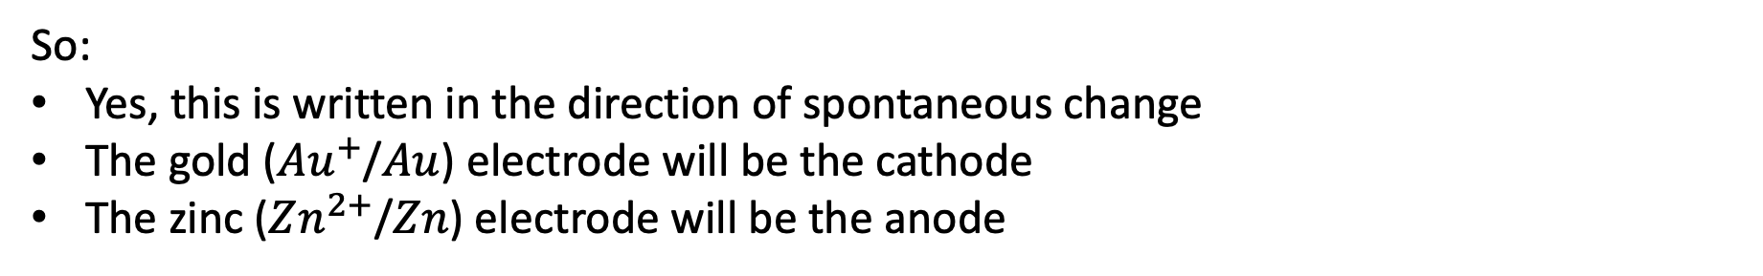
Practice using the electrochemical series to predict the direction of spontaneous change
Which the direction of spontaneous change? Which is anode/cathode?
${Zn}^{2+}$ wins
$$Zn\left(s\right)+2 {Au}^{+}\left(aq\right)→Zn^{2+}\left(aq\right)+2 Au(s)$$
${Au}^{+}$wins
So:
Yes, this is written in the direction of spontaneous change
The gold (${Au}^{+}$/$Au$) electrode will be the cathode
The zinc ($Zn^{2+}$/$Zn$) electrode will be the anode

Slide 32

Practice using the electrochemical series to predict the direction of spontaneous change
Written in the direction of spontaneous change?
$$Sn\left(s\right)+Mg^{2+}\left(aq\right)→Sn^{2+}\left(aq\right)+Mg(s)$$

Slide 33

Predicting the direction of spontaneous change
Written in the direction of spontaneous change?
$$Sn\left(s\right)+Mg^{2+}\left(aq\right)→Sn^{2+}\left(aq\right)+Mg(s)$$
No!

Slide 34

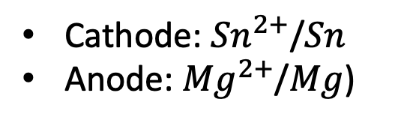
Predicting the direction of spontaneous change
This is written in the direction of spontaneous change.
$$Sn^{2+}\left(aq\right)+Mg\left(s\right)→Sn\left(s\right)+Mg^{2+}\left(aq\right)$$
Cathode: ${Sn}^{2+}$/$Sn$
Anode: ${Mg}^{2+}$/$Mg$)

Slide 35
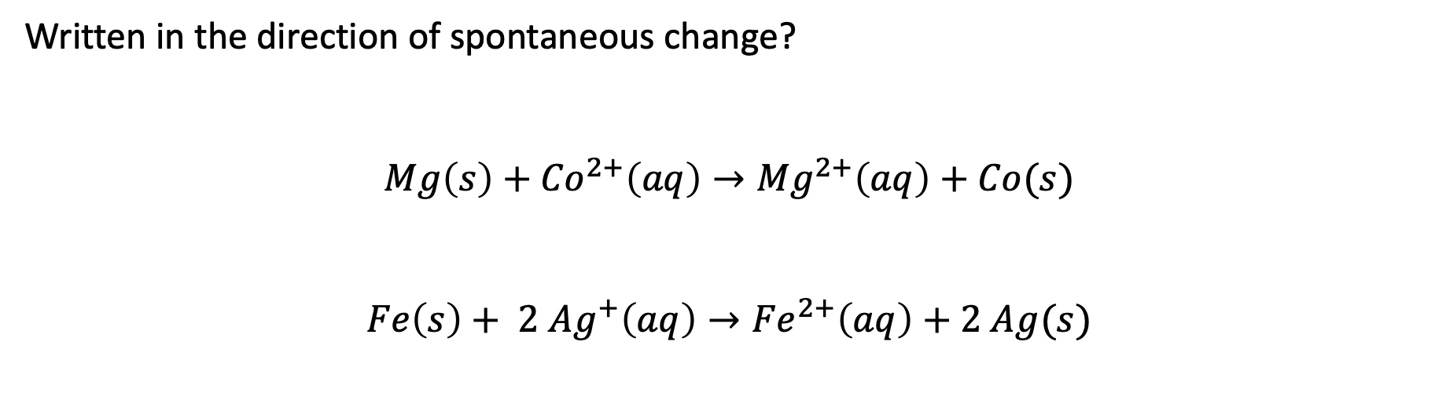
Predicting the direction of spontaneous change
Written in the direction of spontaneous change?
$$Mg\left(s\right)+{Co}^{2+}\left(aq\right)→{Mg}^{2+}\left(aq\right)+Co(s)$$
$$Fe\left(s\right)+ 2 {Ag}^{+}\left(aq\right)→{Fe}^{2+}\left(aq\right)+2 Ag(s)$$

Slide 36
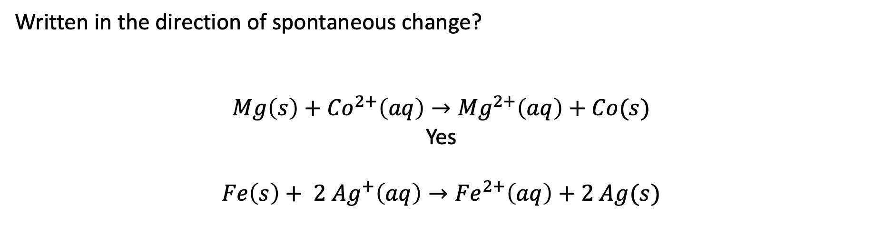
Predicting the direction of spontaneous change
Written in the direction of spontaneous change?
$$Mg\left(s\right)+{Co}^{2+}\left(aq\right)→{Mg}^{2+}\left(aq\right)+Co(s)$$
Yes
$$Fe\left(s\right)+ 2 {Ag}^{+}\left(aq\right)→{Fe}^{2+}\left(aq\right)+2 Ag(s)$$

Slide 37
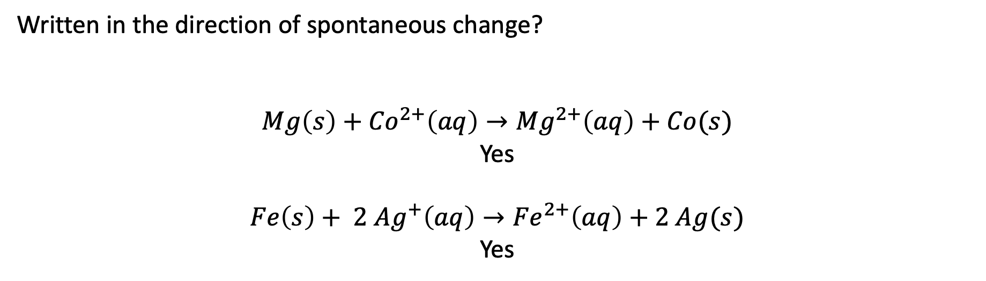
Predicting the direction of spontaneous change
Written in the direction of spontaneous change?
$$Mg\left(s\right)+{Co}^{2+}\left(aq\right)→{Mg}^{2+}\left(aq\right)+Co(s)$$
Yes
$$Fe\left(s\right)+ 2 {Ag}^{+}\left(aq\right)→{Fe}^{2+}\left(aq\right)+2 Ag(s)$$
Yes

Slide 38
Predicting direction of spontaneous change without a table (!)
Patterns:
Metals used for coins (copper, silver, gold, tin) are generally high on the list (their cations really want electrons)
Alkali Earth Metals (Magnesium, Calcium, …) and Alkali Metal ions (Lithium, Sodium, …) are really low on this (their cations are terrible at getting electrons)
Most other metals are in between

Slide 39
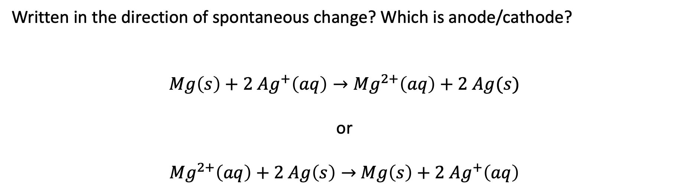
Predicting the direction of spontaneous change
Written in the direction of spontaneous change? Which is anode/cathode?
$$Mg\left(s\right)+2 {Ag}^{+}\left(aq\right)→{Mg}^{2+}\left(aq\right)+2 Ag(s)$$
or
${Mg}^{2+}\left(aq\right)+2 Ag\left(s\right)→$ $Mg\left(s\right)+2 {Ag}^{+}\left(aq\right)$

Slide 40
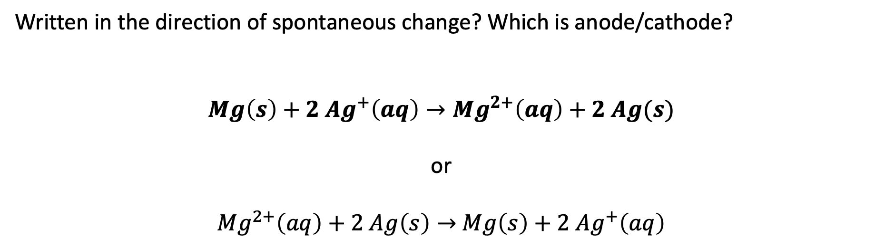
Predicting the direction of spontaneous change
Written in the direction of spontaneous change? Which is anode/cathode?
$$Mg\left(s\right)+2 {Ag}^{+}\left(aq\right)→{Mg}^{2+}\left(aq\right)+2 Ag(s)$$
or
${Mg}^{2+}\left(aq\right)+2 Ag\left(s\right)→$ $Mg\left(s\right)+2 {Ag}^{+}\left(aq\right)$

Slide 41
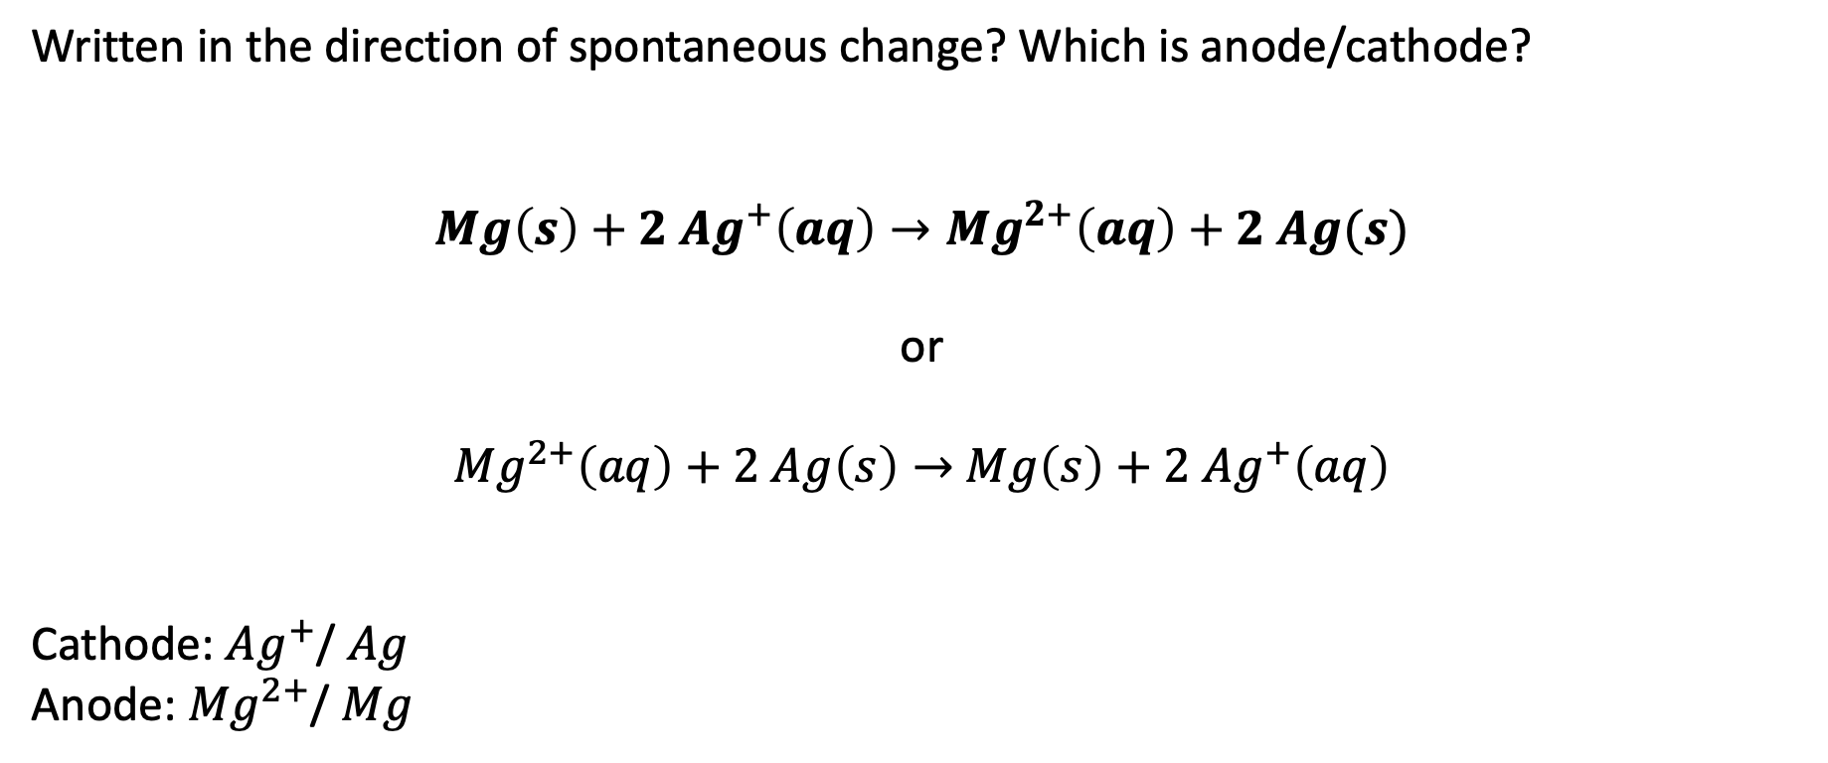
Predicting the direction of spontaneous change
Written in the direction of spontaneous change? Which is anode/cathode?
$$Mg\left(s\right)+2 {Ag}^{+}\left(aq\right)→{Mg}^{2+}\left(aq\right)+2 Ag(s)$$
or
${Mg}^{2+}\left(aq\right)+2 Ag\left(s\right)→$ $Mg\left(s\right)+2 {Ag}^{+}\left(aq\right)$
Cathode: ${Ag}^{+}$/ $Ag$
Anode: ${Mg}^{2+}$/ $Mg$

Slide 42
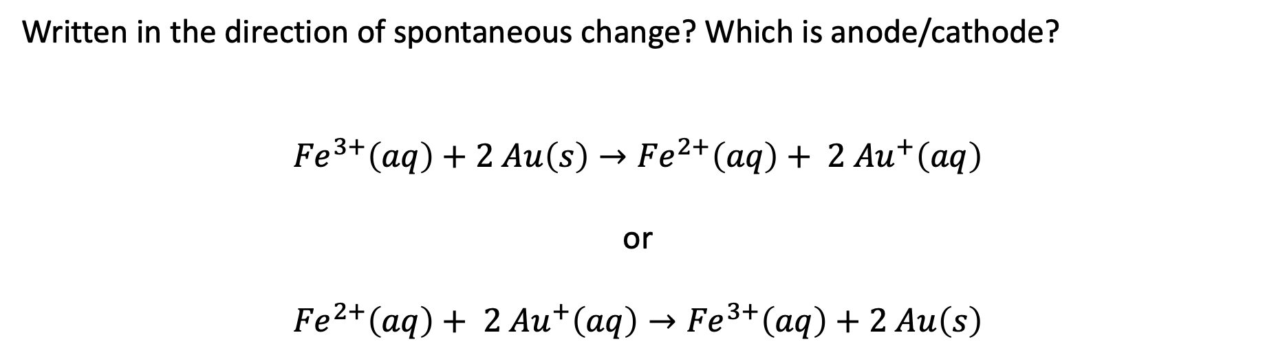
Predicting the direction of spontaneous change
Written in the direction of spontaneous change? Which is anode/cathode?
$${Fe}^{3+}\left(aq\right)+2 Au\left(s\right)→{Fe}^{2+}\left(aq\right)+ 2 {Au}^{+}\left(aq\right)$$
or
$${Fe}^{2+}\left(aq\right)+ 2 {Au}^{+}\left(aq\right)→{Fe}^{3+}\left(aq\right)+2 Au\left(s\right)$$

Slide 43
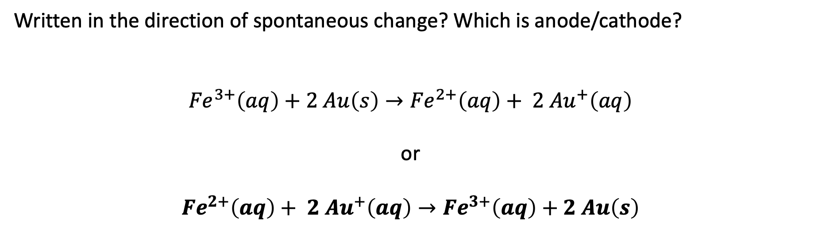
Predicting the direction of spontaneous change
Written in the direction of spontaneous change? Which is anode/cathode?
$${Fe}^{3+}\left(aq\right)+2 Au\left(s\right)→{Fe}^{2+}\left(aq\right)+ 2 {Au}^{+}\left(aq\right)$$
or
$${Fe}^{2+}\left(aq\right)+ 2 {Au}^{+}\left(aq\right)→{Fe}^{3+}\left(aq\right)+2 Au\left(s\right)$$

Slide 44
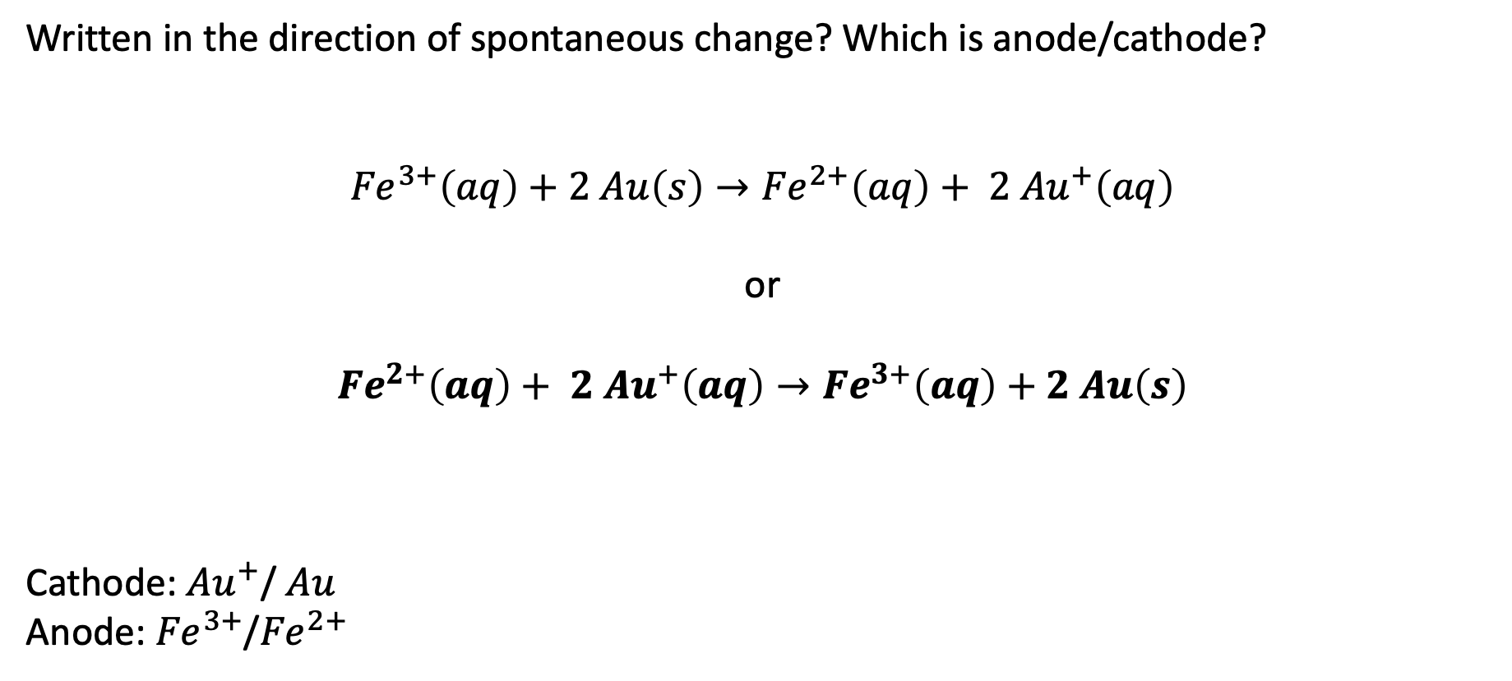
Predicting the direction of spontaneous change
Written in the direction of spontaneous change? Which is anode/cathode?
$${Fe}^{3+}\left(aq\right)+2 Au\left(s\right)→{Fe}^{2+}\left(aq\right)+ 2 {Au}^{+}\left(aq\right)$$
or
$${Fe}^{2+}\left(aq\right)+ 2 {Au}^{+}\left(aq\right)→{Fe}^{3+}\left(aq\right)+2 Au\left(s\right)$$
Cathode: ${Au}^{+}$/ $Au$
Anode: ${Fe}^{3+}$/${Fe}^{2+}$

